Slide 1
Internship at Blinqlabs
Swati S Mathpati
Soumyashree DS

Slide 2
20/10/2020
Full stack development:
Full stack development is made up 3 layers:
The user facing side or front end that handles the presentation portion of
the page or the website. Eg: HTML, CSS AND JS etc
The business logic page or the back end handles information validations. Eg:Java, Python etc
Database keeps track of the information exchanged.Eg:MySQL, MongoDB, Oracle etc
Java:
Java has 3 Components namely:
JDK(Java Development Kit)- is a key component for building java application
JRE(Java Runtime Environment)-provides environment to run the existing java programs.
JVM(Java Virtual Machine)-environment in which java bytecode can be executed.

Slide 3
IDE (Integrated development environment) - It contains a code editor, a compiler or interpreter, and a debugger, accessed through a single graphical user interface(GUI). Eg : Eclipse, Spring Tool Suite, pycharm etc.
Ports - In computer networking, a port is a communication endpoint. At the software level, a port is a logical construct that identifies a specific process or a type of network service.
Firewalls - A computer firewall is a software program that prevents unauthorized access to or from a private network.
DevOps - It combines Developer and manual work together, hence there is no segregations and it is automated.
AWS- AWS offers reliable, scalable and inexpensive cloud computing services

Slide 4
21/10/2020
Installation of JAVA JDk 11 and Eclipse.
Configuration of Eclipse ,i.e, to set it’s memory size and to configure with Java.
Configuration of Spring Tool Suite (STS) with Java.
Eclipse:
It is an IDE having both Spring and Struts, these are java framework. Basically Spring is used to provides a ready-to-use environment to implement, run, deploy, and debug the application. A perspective is a view that contains a series of content editors and visual container. Default perspective is called Java.
Spring Tool Suite:
STS is an IDE to develop Spring applications. It is an Eclipse-based development environment.
Spring Framework: It is an open source Java platform that promotes good software coding practices and speed up development.

Slide 5
RAM(Random Access Memory)
It is a super fast and temporary data memory data storage space that a computer needs to access right now or in the next few moments. RAM is a volatile memory, which means it doesn't not store data or instructions permanently.
Server:
It is a piece of computer hardware or software that provides functionality for other programs and devices called clients.
There are different types of servers :
Web Servers: It mainly deals with sending HTML for displaying the web brower .
Application Server: It provides access to business logic for use by client application programs meaning it exposes business logic to the clients, which generates dynamic content.
Proxy Server: It acts as a gateway between user and the internet. It is an intermediary server separating end users from the website they browse.

Slide 6
22/10/2020
Application Server
An Application server enables a server to generate a dynamic, customized response to a client request. It is a Java Virtual Machine(JVM) that runs user applications. It collaborates with the web server to return a dynamic, customized response to a client request.A virtual machine(VM) is a software computer used as emulation of an actual physical computer. Eg. Apache Tomcat, Weblogic, Glassfish etc.
Apache Tomcat: Apache is an American Ancient Tiger. Apache Tomcat is a software component that allows web developers to build and maintain dynamic websites and applications based on the Java software platform. It was developed by Apache Software foundation.Tomcat is a FOS also called freeware ,i.e, free softwares.
Download and install tar.gz file from binary distribution of Tomcat 9. Versions with alpha or beta are still under process of development.They might have debugs.
Installation of 7 Zip for windows to unzip tar.gz files.

Slide 7
23/08/2020
Zip file - All the file that are compressed and packaged into one file.
Tar file - It is a software utility for collecting many files into one archive file. Tar.gz file format is a combination TAR packaging followed by GNU zip(gzip) compression.
Linux is a family of open-source Unix like operating system. Fedora, Ubuntu, IOS etc is built on Linux.
Linux commands
pwd - present working directory
wget - Web get
yum - Package installer
apt - application installer
rm -1(file name) - to delete directory
netstat- Network Statistics
netstat -ntp / netstat -ntlp - To check specific port no. for windows and linux respt.
Netstat | findstat : / netstat -ntlp | grep :81 - to check if port is available.

Slide 8
Ports - In computer networking, a port is a communication endpoint. At the software level, a port is a logical construct that identifies a specific process or a type of network service.
Port numbers are divided into 3 ranges:
Well-known ports : (Also called System ports) Ranges from 0 to 1024.
Registered ports : Ranges from 1024 to 49151.
Dynamic or private port : Ranges from 49152 to 65535.
Basic ports and their functionalities
Ports Functions
20 File transfer protocol (FTP) Data transfer
23 TELNET
25 Simple mail transfer protocol(SMTP)E-mail routing
53 Domain name system(DNS)
80 HTTP used in WWW
143 Internet message access protocol(IMAP)
443 HTTPS

Slide 9
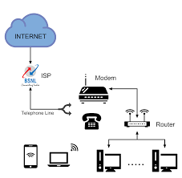
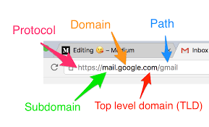
26/10/20
-Installation of web page into the Apache.
(we can install n-number of applications
inside Tomcat9 i.e web application.)
-Internet working and it’s connectivity.
-ISP ( Internet Service Provider)
-DNS (Domain Name Server)
-Sub domain:
In DNS hierarchy, a subdomain is a domain p
that is a part of another(main) domain.
Mentioned as: subdomain.domain.com.

Slide 10
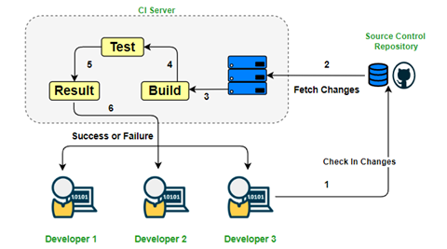
27/10/20
Source code management system : is used to track modifications to a source code repository. SCM tracks a running history of changes to a code base and helps resolve conflicts when merging updates from multiple contributors. Eg., Gitup, gitlab etc
Git : It is designed for coordinating work among programmers, but it can be used to track changes in any set of files.
All the repository will be saved in the server
Installing git in the system
1. Enter git --version at the command line to check if you
already have Git Installed.
2.Configuring the git username and email using the command
$ git config --global user.name “name” $ git config --global
user.email”mail”

Slide 11
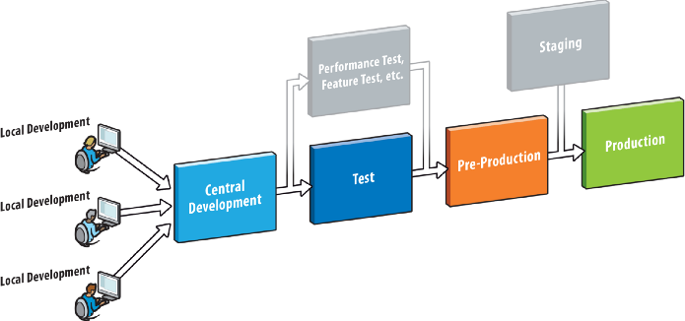
28/10/20
A common 4-tier architecture in software development are
Development
Testing
Pre-production
Production

Slide 12
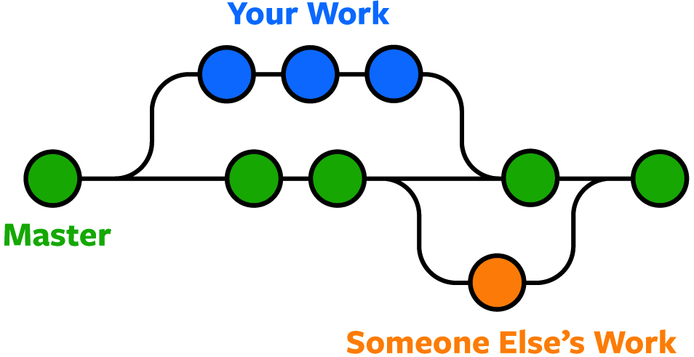
Each repository has one master/ Truck file which consist of main file and following to that are branch. The code which is initially written is placed in master file
Master file
Branch
Branch
Types of branch
1.Release branch : Helps to
Isolate the development of
Upcoming version and Current version
2.Feature branch : It is a copy of
the main codebase where developers can work on new feature

Slide 13

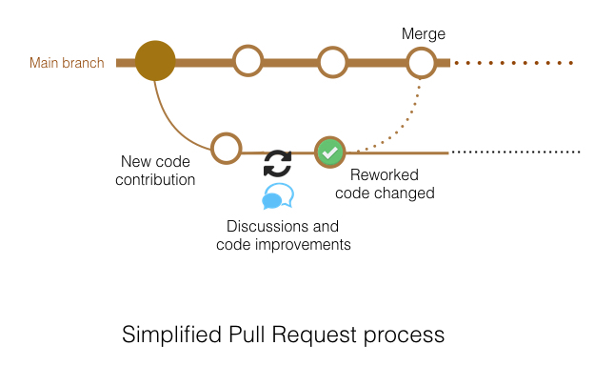
30/10/20
GitHub:
-Repository : Fiberfusion.
-Main (Master)
-Pull requests
-Actions
-Project
-Security
-Insights
-

